Slide 1
THE GEORGE WASHINGTON UNIVERSITY
School of Engineering and Applied Science
Department of Computer Science
Progress Review #4
for the
Voice Launch
By
Amir Raminfar
CSci 196-11
Senior Computer Science Design Project
Sunday, November 8, 2026

Slide 2
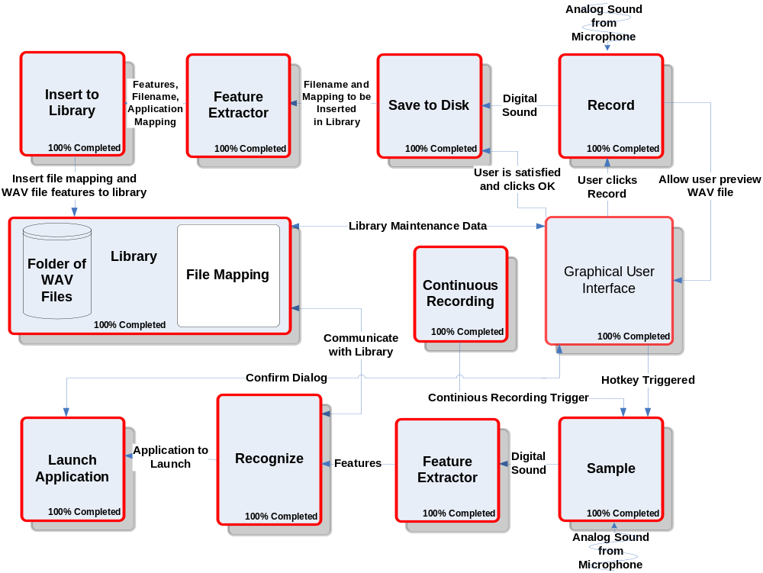
BLOCK DIAGRAM

Slide 3
Module List
Module Name | % Comp | Called By | It Calls | Lines Est. | Lines Coded | Lines Rem. | Hours Coded | Hours Rem. | $ to Code
RECORD | 100% | GUI | GUI | 500 | 150 | 0 | 3 | 0 | $ 120
SAVE TO DISK | 100% | Library | - | 600 | 50 | 0 | 1 | 0 | $ 40
INSERT TO LIBRARY | 100% | Library | - | 1,000 | 200 | 0 | 4 | 0 | $ 160
SAMPLE | 100% | GUI | Recognize | 500 | 150 | 0 | 2 | 0 | $ 80
RECOGNIZE | 100% | Sample | Launch Application | 1,500 | 490 | 0 | 11 | 0 | $ 440
LAUNCH APPLICATION | 100% | Recognize | - | 100 | 50 | 0 | 1 | 0 | $ 40
FEATURE EXTRACTOR | 100% | Library/Recognize | - | 1,000 | 200 | 0 | 5 | 0 | $ 200
LIBRARY | 100% | - | - | 300 | 300 | 0 | 4 | 0 | $ 160
GUI | 100% | User | - | 1,600 | 1,700 | 0 | 34 | 0 | $ 1,360
TOTAL | 100% |  |  | 7,100 | 3,290 | 0 | 65 | 0 | $2,600
5

Slide 4
Tests to Verify the Design
Module Name | Input | Expected Result | Status
Record | Analog Sound | To be digitized and played successfully after recording. | Pass
Record | Analog Sound | Test with a quiet room. | Pass
Record | Analog Sound | Record with microphone. | Pass
Record | Analog Sound | Record with other sources besides a microphone. | Pass
Save to File | Sound from Record module | Digital sound to be saved on disk and played through a third-party WAV player. | Pass
Feature Extractor | WAV file | Successfully divided into 100 uniform intervals. | Pass
Feature Extractor | WAV file | The correct number of zero-crossings for 500 samples should be extracted. | Pass
Feature Extractor | WAV file | The correct number of zero -crossings for all interval should be extracted successfully. | Pass
Feature Extractor | WAV file | The correct number of average time for each interval is returned. | Pass

Slide 5
Tests to Verify the Design
Module Name | Input | Expected Result | Status
Insert to Library | WAV file from save to disk module | Open and write to file successfully. | Pass
Insert to Library | WAV file from save to disk module | Extract should be successfully written to file. | Pass
Sample | Analog Sound | Digitized and played successfully after recording. | Pass
Recognize | Digital sound from sample module | Stepped through the matrix successfully. | Pass
Recognize | Digital sound from sample module | Matrix created successfully. | Pass
Recognize | Digital sound from sample module | Template with best match and within threshold is returned. | Pass
Launch Application | Application address from recognize module | Application should be launched. | Pass
Library | WAV files | All templates should be returned in a matrix. When needed it should return all WAV files to the GUI. | Pass

Slide 6
Tests to Verify the Design
Module Name | Input | Expected Result | Status
GUI | Events are triggered by user | Buttons can trigger a number of events ranging from recording to recognition. | Pass
GUI | Hotkey | Hotkey should trigger the recording to being | Pass
GUI | Events are triggered by user | Buttons can trigger a number of events ranging from recording to recognition. | Pass
Accuracy | Application name via voice x 10 time | At least 8 of the 10 tries are successful | Pass
Accuracy | The above test times done with 5 different application names | At least 8 of the 10 tries are successful for each try | Pass

Slide 7
GANTT CHART
See MS-Project File

Slide 8
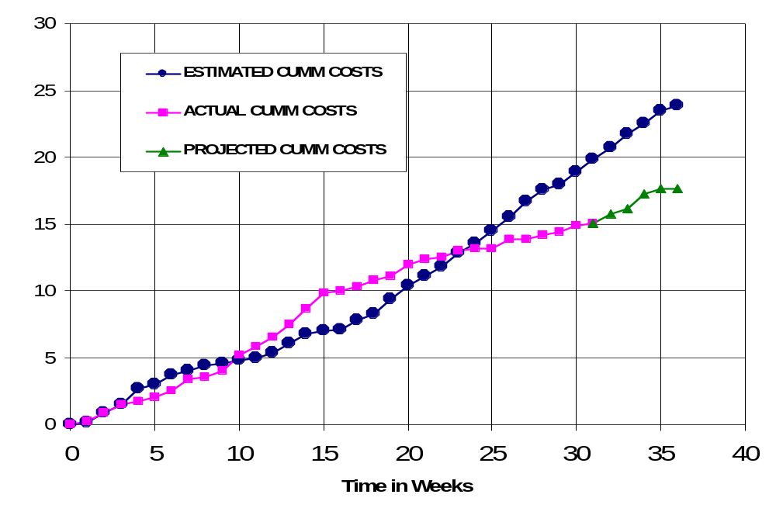
CUMULATIVE LABOR COSTS

Slide 9
ECONOMIC ANALYSIS
PROTOTYPE COSTS
 | Labor Rate | Initial Est. Hours | Initial Est. Cost | Current Est. Hours | Current Est. Cost
System Analyst | $45.00 | 215 | $9,686 | 113 | $5,085
Programmer | $40.00 | 268 | $10,720 | 68 | $2,720
Test Programmer | $35.00 | 31 | $1,085 | 91 | $3,185
Technical Writer | $35.00 | 67 | $2,345 | 190 | $6,650
TOTAL |  | 581 | $23,836 | 462 | $17,640
DIRECT OVERHEAD @ 100% |  |  | $23,836 |  | $17,640
SUBTOTAL |  |  | $47,673 |  | $35,280
A&G COSTS @ 40% |  |  | $19,069 |  | $14,112
SUBTOTAL |  |  | $66,742 |  | $49,392
PROFIT @ 20% |  |  | $13,348 |  | $9,878
TOTAL COST OF PROTOTYPE |  |  | $80,090 |  | $59,270

Slide 10
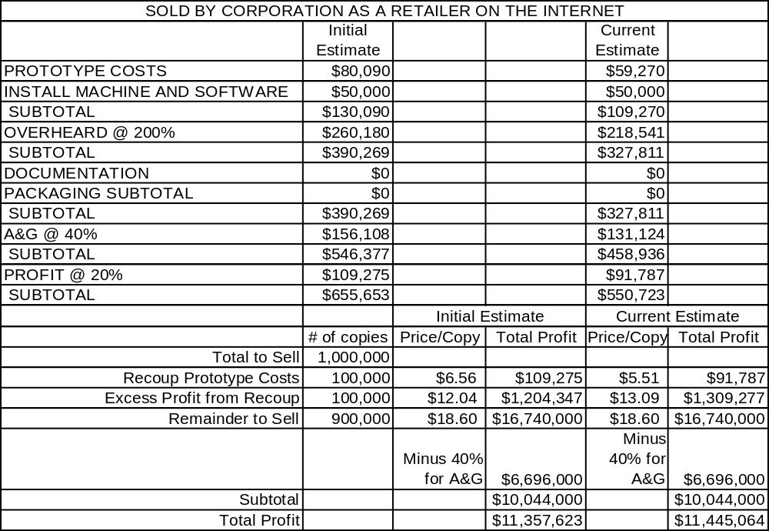
UNIT COSTS SOLD

Slide 11
OUTLINED MATRIX
OUTLINED
MODULE NAME | INIT. EST. HRS. | CUR. EST. HRS. | HRS SPENT TO DATE | % COMPT. | EST. HRS TO COMP.
RECORD | 8 | 8 | 8 | 100% | 0
SAVE TO DISK | 7 | 5 | 5 | 100% | 0
INSERT TO LIBRARY | 5 | 5 | 5 | 100% | 0
SAMPLE | 3 | 3 | 3 | 100% | 0
RECOGNIZE | 12 | 5 | 5 | 100% | 0
LAUNCH APPLICATION | 2 | 2 | 2 | 100% | 0
FEATURE EXTRACTOR | 0 | 2 | 2 | 100% | 0
LIBRARY | 2 | 2 | 2 | 100% | 0
GUI | 2 | 2 | 2 | 100% | 0
TOTALS | 41 | 34 | 34 | 100% | 0

Slide 12
DESIGNED MATRIX
DESIGNED
MODULE NAME | INIT. EST. HRS. | CUR. EST. HRS. | HRS SPENT TO DATE | % COMPT. | EST. HRS TO COMP.
RECORD | 6 | 5 | 5 | 100% | 0
SAVE TO DISK | 7 | 4 | 4 | 100% | 0
INSERT TO LIBRARY | 6 | 8 | 8 | 100% | 0
SAMPLE | 4 | 5 | 5 | 100% | 0
RECOGNIZE | 12 | 25 | 25 | 100% | 0
LAUNCH APPLICATION | 3 | 4 | 4 | 100% | 0
FEATURE EXTRACTOR | 0 | 3 | 3 | 100% | 0
LIBRARY | 2 | 2 | 2 | 100% | 0
GUI | 4 | 4 | 4 | 100% | 0
TOTALS | 44 | 60 | 60 | 100% | 0

Slide 13
CONSTRUCTED MATRIX
CONSTRUCTED
MODULE NAME | INIT. EST. HRS. | CUR. EST. HRS. | HRS SPENT TO DATE | % COMPT. | EST. HRS TO COMP.
RECORD | 40 | 3 | 3 | 100% | 0
SAVE TO DISK | 20 | 1 | 1 | 100% | 0
INSERT TO LIBRARY | 28 | 4 | 4 | 100% | 0
SAMPLE | 40 | 2 | 2 | 100% | 0
RECOGNIZE | 120 | 10 | 10 | 100% | 0
LAUNCH APPLICATION | 20 | 1 | 1 | 100% | 0
FEATURE EXTRACTOR | 0 | 5 | 5 | 100% | 0
LIBRARY | 4 | 4 | 4 | 100% | 0
GUI | 15 | 35 | 35 | 100% | 0
TOTALS | 287 | 65 | 65 | 100% | 0

Slide 14
TESTED MATRIX
TESTED
MODULE NAME | INIT. EST. HRS. | CUR. EST. HRS. | HRS SPENT TO DATE | % COMPT. | EST. HRS TO COMP.
RECORD | 6 | 5 | 5 | 100% | 0
SAVE TO DISK | 4 | 1 | 1 | 100% | 0
INSERT TO LIBRARY | 4 | 9 | 9 | 100% | 0
SAMPLE | 4 | 2 | 2 | 100% | 0
RECOGNIZE | 10 | 5 | 5 | 100% | 0
LAUNCH APPLICATION | 3 | 1 | 1 | 100% | 0
FEATURE EXTRACTOR | 0 | 7 | 7 | 100% | 0
LIBRARY | 2 | 10 | 10 | 100% | 0
GUI | 4 | 10 | 10 | 100% | 0
TOTALS | 37 | 50 | 50 | 100% | 0

Slide 15
INTEGRATED MATRIX
INTEGRATED
MODULE NAME | INIT. EST. HRS. | CUR. EST. HRS. | HRS SPENT TO DATE | % COMPT. | EST. HRS TO COMP.
RECORD | 4 | 5 | 5 | 100% | 0
SAVE TO DISK | 4 | 1 | 1 | 100% | 0
INSERT TO LIBRARY | 3 | 9 | 9 | 100% | 0
SAMPLE | 1 | 1 | 1 | 100% | 0
RECOGNIZE | 6 | 1 | 1 | 100% | 0
LAUNCH APPLICATION | 2 | 1 | 1 | 100% | 0
FEATURE EXTRACTOR | 0 | 2 | 2 | 100% | 0
LIBRARY | 2 | 4 | 4 | 100% | 0
GUI | 20 | 6 | 6 | 100% | 0
TOTALS | 42 | 30 | 30 | 100% | 0

Slide 16
DOCUMENTED MATRIX
DOCUMENTED
MODULE NAME | INIT. EST. HRS. | CUR. EST. HRS. | HRS SPENT TO DATE | % COMPT. | EST. HRS TO COMP.
RECORD | 15 | 21 | 19 | 90.5% | 2
SAVE TO DISK | 13 | 11 | 9 | 81.8% | 2
INSERT TO LIBRARY | 15 | 15 | 12 | 80.0% | 3
SAMPLE | 15 | 11 | 11 | 100.0% | 0
RECOGNIZE | 25 | 18 | 15 | 83.3% | 3
LAUNCH APPLICATION | 15 | 11 | 11 | 100.0% | 0
FEATURE EXTRACTOR | 0 | 15 | 12 | 80.0% | 3
LIBRARY | 1 | 12 | 10 | 83.3% | 2
GUI | 2 | 22 | 16 | 72.7% | 6
TOTALS | 101 | 136 | 115 | 84.6% | 21

Slide 17
TOTAL MATRIX
TOTAL
MODULE NAME | INIT. EST. HRS. | CUR. EST. HRS. | HRS SPENT TO DATE | % COMPT. | EST. HRS TO COMP.
RECORD | 79 | 47 | 45 | 95.7% | 2
SAVE TO DISK | 55 | 23 | 21 | 91.3% | 2
INSERT TO LIBRARY | 61 | 50 | 47 | 94.0% | 3
SAMPLE | 67 | 24 | 24 | 100.0% | 0
RECOGNIZE | 185 | 64 | 61 | 95.3% | 3
LAUNCH APPLICATION | 45 | 20 | 20 | 100.0% | 0
FEATURE EXTRACTOR | 0 | 34 | 31 | 91.2% | 3
LIBRARY | 13 | 34 | 32 | 94.1% | 2
GUI | 47 | 79 | 73 | 92.4% | 6
CLASS TIME | 87 | 87 | 72 | 82.8% | 15
TOTALS | 639 | 462 | 426 | 92.2% | 36

